Slide 1
Finger Vein Recognition System using Maximum curvature Points
Submitted in the partial fulfillment for the award of the degree of
BACHELOR OF ENGINEERING
IN
INFORMATION SECURITY
Submitted by:
Abhishek Mishra – 20BCS3642 Tolesh Pathak – 20BCS3521 Abhay Tomer – 20BCS3566
Under the Supervision of:
Abhishek Ankur
Department of AIT-CSE
DISCOVER . LEARN . EMPOWER

Slide 2
Outline
Introduction to Project
Problem Formulation
Objectives of the work
Methodology used
Results and Outputs
Conclusion
Future Scope
References

Slide 3
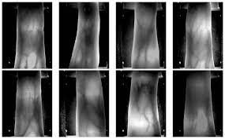
Introduction to Project
Biometric authentication holds immense importance in contemporary security scenarios. This project focuses on developing an Advanced Finger Vein Recognition System by harnessing the power of the Maximum Curvature Point method. This presentation outlines our primary objectives and the methodology that drives this innovation.

Slide 4
Problem Formulation
- Advanced Finger Vein Recognition System: Developing an innovative system using Maximum Curvature Point method for biometric authentication enhancement.
- Primary Objectives: Addressing challenges in security, accuracy, user comfort, and efficiency.
- Security Enhancement: Leveraging unique and complex finger vein patterns to reinforce biometric authentication security.
- Mathematical Refinement: Optimizing feature extraction for improved identification precision.
- User-Centric Approach: Ensuring user comfort and privacy with non-intrusive NIR imaging technology.
- Computational Efficiency: Enabling swift data processing while upholding accuracy for real-time applications.
- Adaptability: Crafting a system that adapts to varying environmental conditions without compromising recognition accuracy.

Slide 5
Objectives of the Work
Designing a system that offers exceptional security through finger vein recognition.
Achieving high accuracy and robustness under varying conditions.
Prioritizing user comfort and privacy by utilizing non-intrusive imaging technology.
Optimizing computational efficiency for real-time applications.
Adapting the system to diverse environmental scenarios.
Implementing effective data preprocessing techniques. Introducing a novel feature extraction approach using maximum curvature points.

Slide 6
Methodology used
Dataset Collection:
Collect a diverse dataset of finger vein images.
Include variations in lighting, pose, and finger conditions.
Ensure a balanced representation of positive (matched) and negative (unmatched) samples.
Image Normalization and Enhancement:
Normalize and enhance input images to reduce noise and improve consistency.
Enhance image quality for more accurate feature extraction.
Region of Interest (ROI) Segmentation:
Segment and isolate the region of interest (ROI) containing the finger veins.
Focusing on the relevant area enhances recognition accuracy.
Maximum Curvature Point (MCP) Detection:
Apply MCP detection to extract curvature points.
Analyze local gradients to compute curvature at each pixel.
Identify maximum curvature points as distinctive feature points.
Feature Extraction:
Extract features from the detected MCPs.
These features represent the unique characteristics of finger vein patterns.
Matching:
Compare the extracted features directly for matching.
Utilize matching algorithms to determine the similarity between query and stored templates.

Slide 7
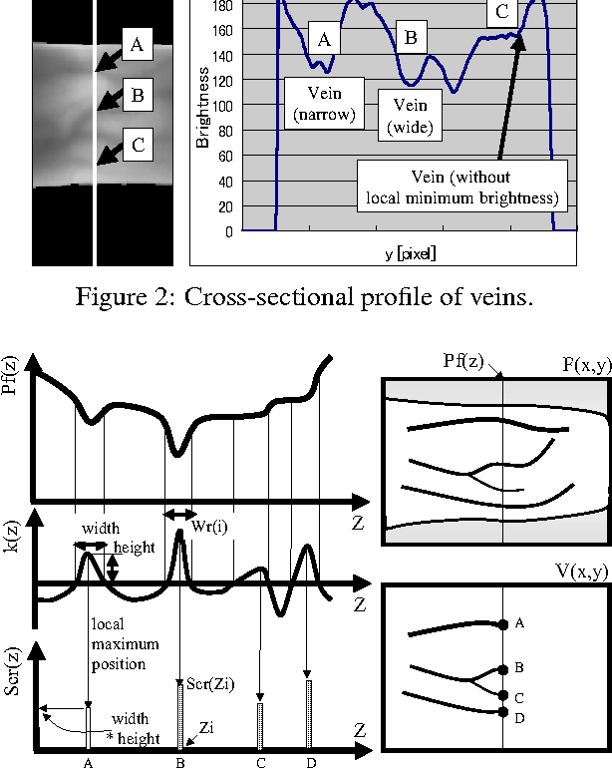
Results and Outputs
An implemented system that will utilize the technology developed during the conceivement of this project.
A robust and refined version of the core algorithm, i.e. Maximum Curvature Points Method.
An application showcasing the implemented methods in the form of user-friendly interface.

Slide 8
Conclusion
Leveraging Maximum Curvature Points for feature extraction enhances biometric authentication by capturing intricate finger vein patterns.
The comprehensive methodology involves dataset diversity, image enhancement, ROI segmentation, MCP detection, and direct feature comparison.
Incorporating machine learning, error handling, and user feedback elevates accuracy and user experience.
Optimizing for real-time processing, privacy, and environmental adaptability ensures practical applicability.
Through continuous testing and refinement, this system presents a promising solution for secure and efficient biometric authentication.

Slide 9
Future Scope
Multimodal Integration: Explore combining finger vein recognition with other biometric modalities like fingerprint or facial recognition for enhanced accuracy and security.
Deep Learning Advancements: Integrate deep learning techniques for automated feature learning, potentially improving recognition accuracy in complex scenarios.
Continuous Authentication: Develop systems that continuously authenticate users during their interaction, ensuring persistent security.
Mobile Integration: Adapt the system for mobile devices, enabling secure access to smartphones and enhancing user convenience.
Anti-Spoofing Measures: Implement advanced anti-spoofing techniques to detect and prevent fraudulent attempts using fake finger vein patterns.
Cross-Platform Compatibility: Create solutions that are compatible with various platforms, from physical access control to online transactions.
Cloud-Based Recognition: Explore cloud-based recognition systems to enable remote authentication and reduce hardware requirements.
Medical Applications: Investigate the use of finger vein recognition in medical scenarios, such as patient identification and access to electronic health records.

Slide 10
References
Miura, Naoto & Nagasaka, Akio & Miyatake, Takafumi. (2004). Feature extraction of finger-vein patterns based on repeated line tracking and its application to personal identification. Machine Vision and Applications. 15. 194-203. 10.1007/s00138-004-0149-2. https://www.researchgate.net/publication/226763366_Feature_extraction_of_finger-vein_patterns_based_on_repeated_line_tracking_and_its_application_to_personal_identification
Y. Song, P. Zhao, W. Yang, Q. Liao and J. Zhou, "EIFNet: An Explicit and Implicit Feature Fusion Network for Finger Vein Verification," in IEEE Transactions on Circuits and Systems for Video Technology, vol. 33, no. 5, pp. 2520-2532, May 2023, doi: 10.1109/TCSVT.2022.3224203. https://ieeexplore.ieee.org/document/8448746
Miura, Naoto & Nagasaka, Akio & Miyatake, Takafumi. (2005). Extraction of Finger-Vein Patterns Using Maximum Curvature Points in Image Profiles. Ieice Transactions - IEICE. E90D. 347-350. 10.1093/ietisy/e90-d.8.1185. https://www.researchgate.net/publication/221280509_Extraction_of_FingerVen_Patterns_Using_Maximum_Curvature_Points_in_Image_Profiles
https://www.mdpi.com/2078-2489/9/9/213

